Slide 1
Machine Translation
PyToorch

Slide 2
Agenda
What is PyTorch?
Why PyTorch?
What is Machine Translation (MT)?
Seq2Sqs Models
Attention Models
Further Readings
Code Time

Slide 3

WHAT IS PYTORCH?
PyTorch is an open source machine learning library used primarily for applications such as computer vision and natural language processing.
It’s a Python-based scientific computing package targeted at two sets of audiences:
A replacement for NumPy to use the power of GPUs
a deep learning research platform that provides maximum flexibility and speed

Slide 4
Why PyTorch?
PyTorch is Pythonic
PyTorch is built to be seamlessly integrated with Python and its popular libraries like NumPy. Check out the code snippet below to see how easy it is to manipulate a NumPy array using PyTorch:

Slide 5
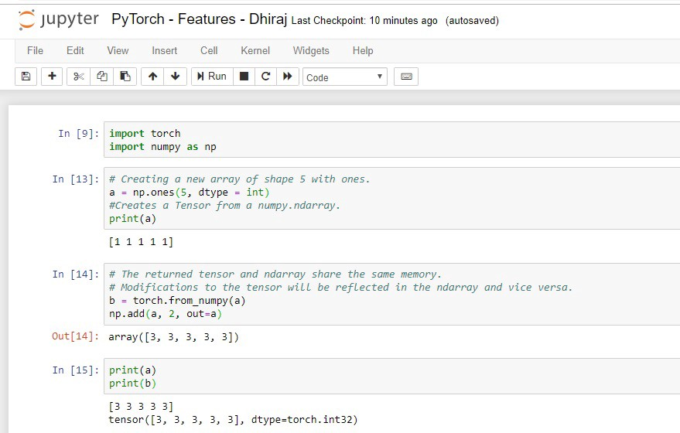

Slide 6
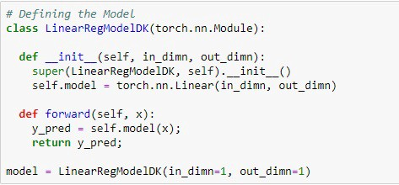
Why PyTorch?
2. Easy to learn
PyTorch is comparatively easier to learn than other deep learning frameworks. This is because its syntax and application are similar to many conventional programming languages like Python.
PyTorch’s documentation is also very organized and helpful for beginners. And a focused community of developers are also helping to continuously improve PyTorch.

Slide 7
Why PyTorch?
3. Higher developer productivity
PyTorch is very simple to use, which also means that the learning curve for developers is relatively short.

Slide 8
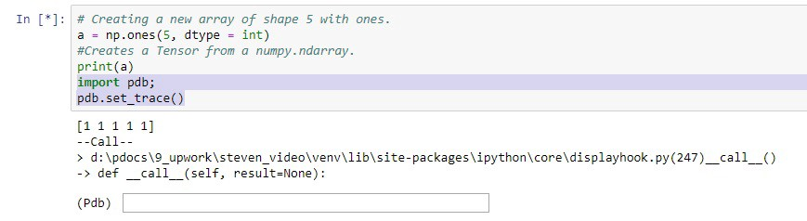
Why PyTorch?
4. Easy debugging
As PyTorch is deeply integrated with Python, many Python debugging tools can also be used in PyTorch code. Specifically, Python’s pdb and ipdb tools can be used for this kind of debugging in PyTorch.

Slide 9
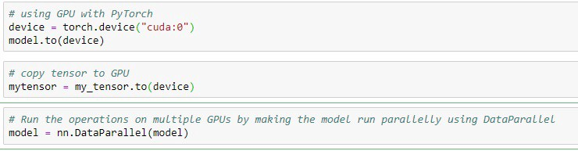
Why PyTorch?
5. Data Parallelism
PyTorch has a very useful feature known as data parallelism. Using this feature, PyTorch can distribute computational work among multiple CPU or GPU cores.
This feature of PyTorch allows us to use torch.nn.DataParallel to wrap any module and helps us do parallel processing over batch dimension.

Slide 10
Why PyTorch?
6. Dynamic Computational Graph Support
PyTorch supports dynamic computational graphs, which means the network behavior can be changed programmatically at runtime. This facilitates more efficient model optimization and gives PyTorch a major advantage over other machine learning frameworks, which treat neural networks as static objects.
With this dynamic approach, we can fully see each and every computation and know exactly what is going on.

Slide 11
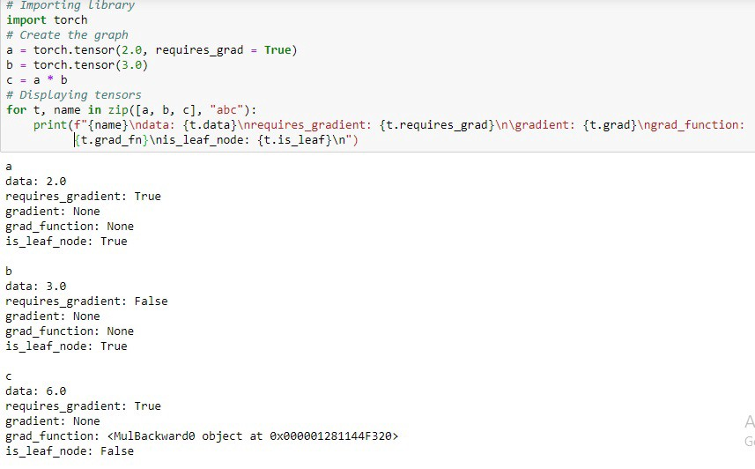

Slide 12
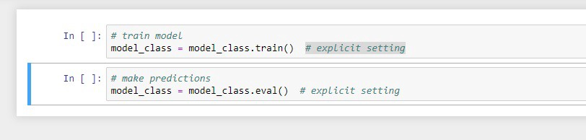
Why PyTorch?
7. Hybrid Front-End
PyTorch also provides a new hybrid front-end. This means we have two modes of operation, namely eager mode and graph mode.
We generally use eager mode for research and development, as this mode provides flexibility and ease of use. And we generally use graph mode for production, as this provides better speed, optimization, and functionality in a C++ runtime environment.

Slide 13
Why PyTorch?
8. Useful Libraries
A large community of developers have built many tools and libraries for extending PyTorch. The community is also supporting development in computer vision, reinforcement learning, and much more.
This will surely bolster PyTorch’s reach as a fully-featured deep learning library for both research and production purposes. Here are a few examples of popular libraries:
GPyTorch is a highly efficient and modular implementation with GPU acceleration. It’s implemented in PyTorch and combines Gaussian processes with deep neural networks.
BoTorch is a PyTorch-related library for Bayesian optimization.
AllenNLP is an open-source NLP research library, built on PyTorch.

Slide 14
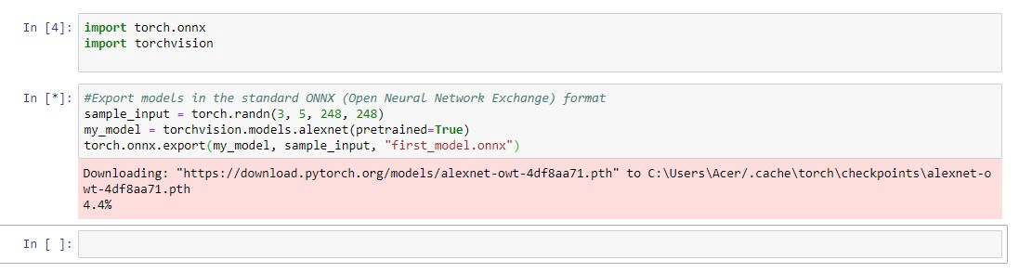
Why PyTorch?
9. Open Neural Network Exchange support
ONNX stands for Open Neural Network Exchange. With ONNX, AI developers can easily move models between different tools and choose the combination that work best for them and their given use case.
PyTorch has native ONNX support and can export models in the standard Open Neural Network Exchange format.
This will enable PyTorch-based models to direct access the ONNX-compatible platforms and run-times.

Slide 15
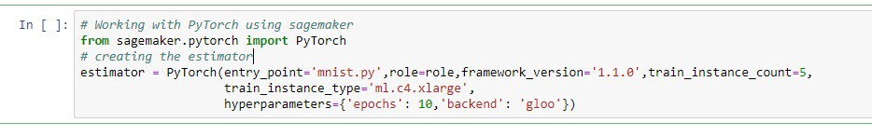
Why PyTorch?
10. Cloud support
PyTorch is also well-received by major cloud platforms, allowing developers and engineers to do large-scale training jobs on GPUs with PyTorch.
PyTorch’s cloud support also provides the ability to run models in a production environment. Not only that, we can also scale our PyTorch model using the cloud. For example, you can use the below code to work with PyTorch using AWS Sagemaker.

Slide 16

Why PyTorch?
Many cloud providers changed their DL platforms into PyTorch, so Why PyTorch

Slide 17
What is Machine Translation (MT)?
Machine translation (MT) refers to fully automated software that can translate source content into target languages. Humans may use MT to help them render text and speech into another language, or the MT software may operate without human intervention.
MT tools are often used to translate vast amounts of information involving millions of words that could not possibly be translated the traditional way. The quality of MT output can vary considerably; MT systems require “training” in the desired domain and language pair to increase quality.
Translation companies use MT to augment productivity of their translators, cut costs, and provide post-editing services to clients. MT use by language service providers is growing quickly. In 2016, SDL—one of the largest translation companies in the world—announced it translates 20 times more content with MT than with human teams.

Slide 18
MT Systems
Generic MT usually refers to platforms such as Google Translate, Bing, Yandex, and Naver. These platforms provide MT for ad hoc translations to millions of people. Companies can buy generic MT for batch pre-translation and connect to their own systems via API.
Customizable MT refers to MT software that has a basic component and can be trained to improve terminology accuracy in a chosen domain (medical, legal, IP, or a company’s own preferred terminology). For example, WIPO’s specialist MT engine translates patents more accurately than generalist MT engines, and eBay’s solution can understand and render into other languages hundreds of abbreviations used in electronic commerce.
Adaptive MT offers suggestions to translators as they type in their CAT-tool, and learns from their input continuously in real time. Introduced by Lilt in 2016 and by SDL in 2017, adaptive MT is believed to improve translator productivity significantly and can challenge translation memory technology in the future.

Slide 19
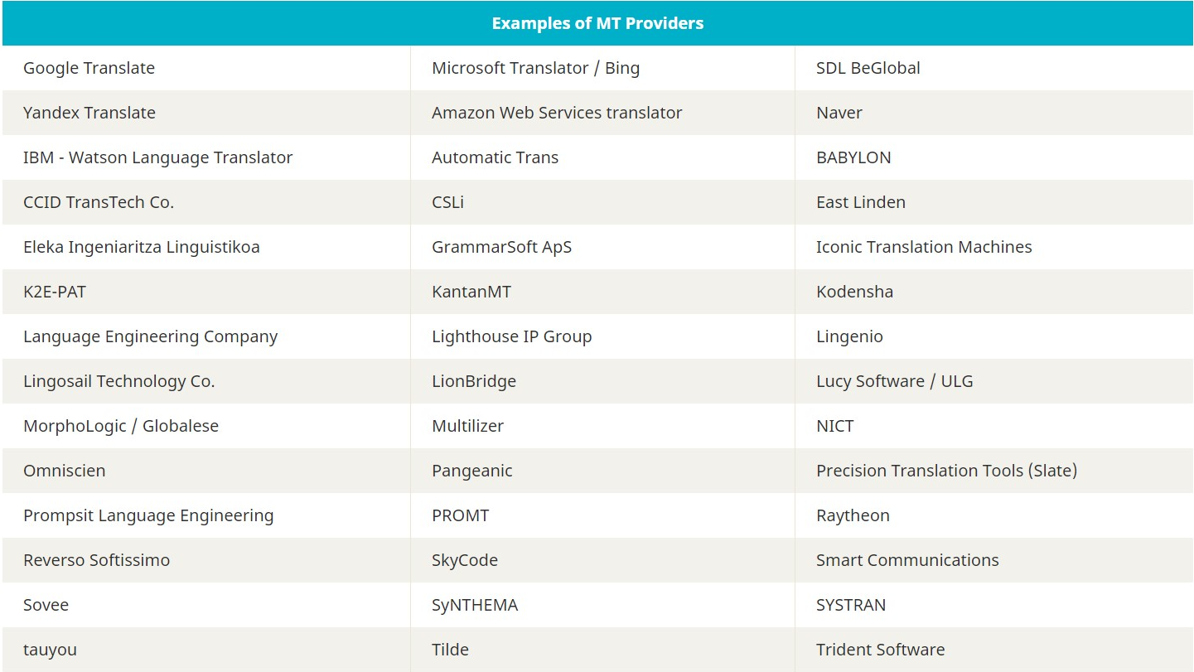

Slide 20
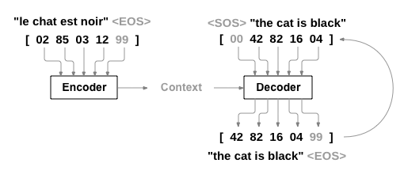
Seq2Sqs Models
A Recurrent Neural Network, or RNN, is a network that operates on a sequence and uses its own output as input for subsequent steps.
A Sequence to Sequence network, or seq2seq network, or Encoder Decoder network, is a model consisting of two RNNs called the encoder and decoder. The encoder reads an input sequence and outputs a single vector, and the decoder reads that vector to produce an output sequence.

Slide 21
Seq2Sqs Models
Unlike sequence prediction with a single RNN, where every input corresponds to an output, the seq2seq model frees us from sequence length and order, which makes it ideal for translation between two languages.
Consider the sentence “Je ne suis pas le chat noir” → “I am not the black cat”. Most of the words in the input sentence have a direct translation in the output sentence, but are in slightly different orders, e.g. “chat noir” and “black cat”. Because of the “ne/pas” construction there is also one more word in the input sentence. It would be difficult to produce a correct translation directly from the sequence of input words.
With a seq2seq model the encoder creates a single vector which, in the ideal case, encodes the “meaning” of the input sequence into a single vector — a single point in some N dimensional space of sentences.

Slide 22
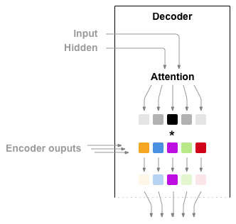
Attention Models
Attention allows the decoder network to “focus” on a different part of the encoder’s outputs for every step of the decoder’s own outputs. First we calculate a set of attention weights. These will be multiplied by the encoder output vectors to create a weighted combination. The result (called attn_applied in the code) should contain information about that specific part of the input sequence, and thus help the decoder choose the right output words.
Calculating the attention weights is done with another feed-forward layer attn, using the decoder’s input and hidden state as inputs. Because there are sentences of all sizes in the training data, to actually create and train this layer we have to choose a maximum sentence length (input length, for encoder outputs) that it can apply to. Sentences of the maximum length will use all the attention weights, while shorter sentences will only use the first few.

Slide 23
Further Readings
Sequence to Sequence Learning with Neural Networks
Neural Machine Translation by Jointly Learning to Align and Translate
A Neural Conversational Model
Effective Approaches to Attention-based Neural Machine Translation

Slide 24

Code Time
https://github.com/mma1979/pytorch-mt-workshop

Slide 25

Thank You
Mohammed Abdelhay
Email: mohammed_abdelhay@pg.cu.edu.eg
Mobile: +201008983687
LinkedIn: https://www.linkedin.com/in/mohammed-abdelhay/
GitHub: https://github.com/mma1979

